Slide 1

Bus segment
2015 Product strategy

Slide 2
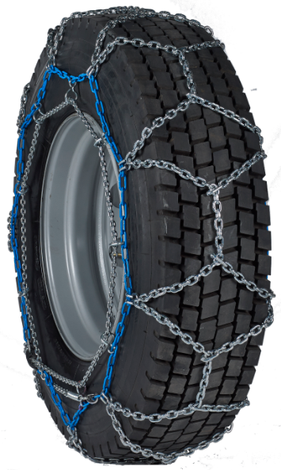
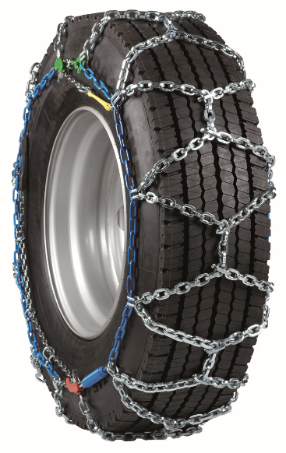
Bus segment
Rigid arch and Flexible cable chains – Bus snow chains for different applications
COACH MASTER
T2 PRO
Agenda

Slide 3
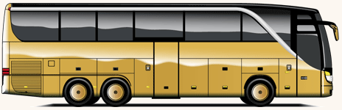
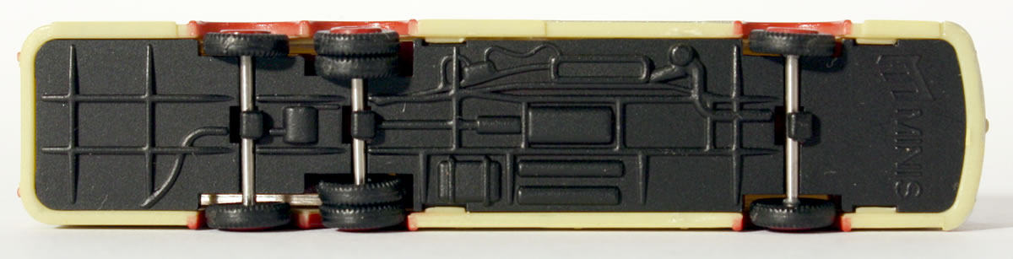
Bus segment
Modern buses configuration
Driving axle
Steering axle
Agenda

Slide 4
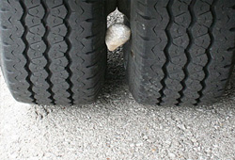
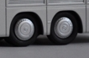
Bus segment
Modern buses can be equipped with different chain models
Rigid arch fitting system
Flexible cable fitting system
Not steering wheels (straight)
Limited clearance between twin tyres
Limited clearance in wheelhouse
Steering wheels
No limited clearance
Axles with twin tyres
Axle with single tyres
Driving axle
Steering axle
Agenda

Slide 5
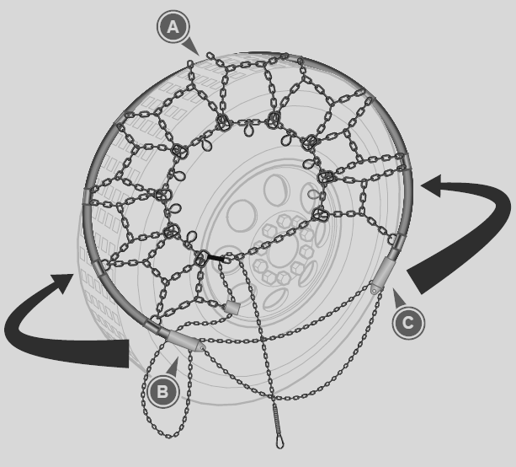
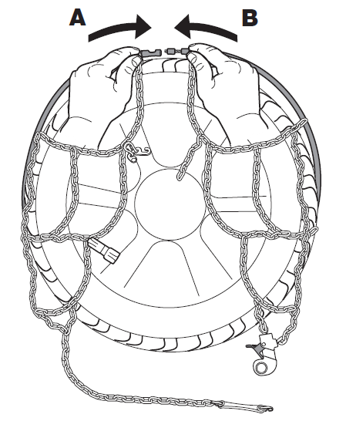
Bus segment
Modern buses needs different chains on different axles
Rigid arch fitting system
Flexible cable fitting system
Driving axle
Steering axle
Agenda

Slide 6
Bus segment: KÖNIG COACH MASTER
Product Overview:
  Vehicle specific product offering a comfortable fittig system for buses equipped with twin tyres.
  It can be installed also on vehicles with limited wheelhouse and between the tyre clearance without lifting the vehicle
Advantages:
  Bus fleets: It can be easily and quickly fitted on many buses
  Tourism buses: it offers a safe fitting without lifting the vehicle, better comfort for driver and occupants
Homologations:
  Ö-Norm V5119
Agenda

Slide 7
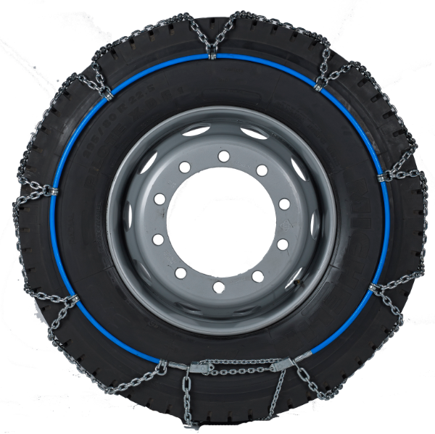

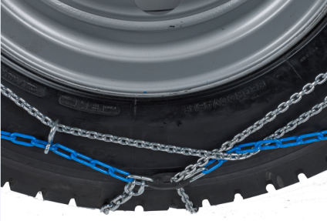
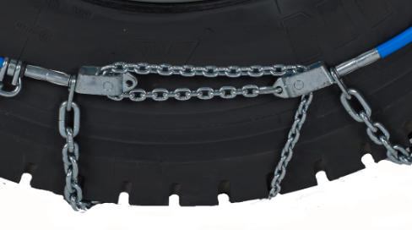
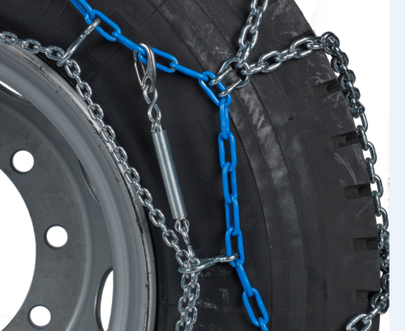
Bus segment: KÖNIG COACH MASTER
Fitting system:
  Rigid arch
Cross-chain pattern:
  6mm round shape wire is the best compromise between driving comfort and performances
Rigid arch closing system featuring two sliding pivots
  It can be comfortably actioned from the outside and it avoids manual closing inside the wheelhouse
Locking device
  Makes the chain safe and reliable and avoids accidental opening during driving
Low pitch hardened tensioning chain:
  For a perfect tensioning and fit on the tyre
Elastic end:
  Spring + simplex for a simple re-tensioning operation
Packed into a nylon bag, containing:
  1 chain pair
  Fitting instructions
  Long gloves
  Repair kit
Agenda

Slide 8
Bus segment: KÖNIG T2 PRO
Product overview:
  Specific for buses with single tyres (i.e. front axle)
Advantages:
  Fitting without moving or lifting the vehicle
Homologations:
  Ö-Norm V5119
Agenda

Slide 9
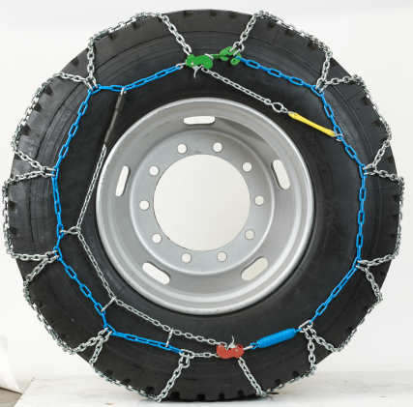
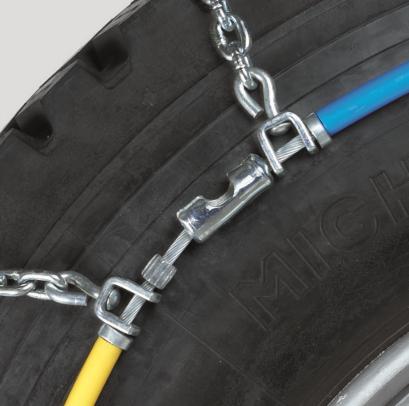
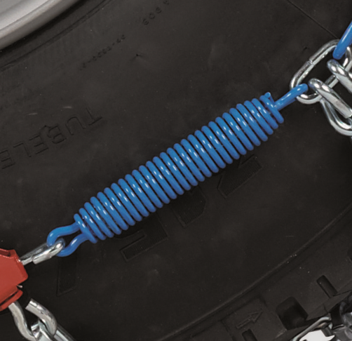
Bus segment: KÖNIG T2 PRO
Fitting system:
  Flexible cable
Cross-chain pattern:
  T2 Pro: 5,70- 6,40 – 7,75mm
    Basing on tyre size
Double locking device to adjust chain tensioning with max precision
Side chain equipped with tensioning spring to adjust the chain on different tyre profiles and with different wear levels
Agenda

Slide 10
Bus segment: KÖNIG COACH MASTER + T2 PRO
Ideal equipment for a modern bus
1 pair of Rigid Arch chain for the axles with twin tyres
1 pair of Flexible cable chains for the axles with single tyres
Agenda

